Slide 1
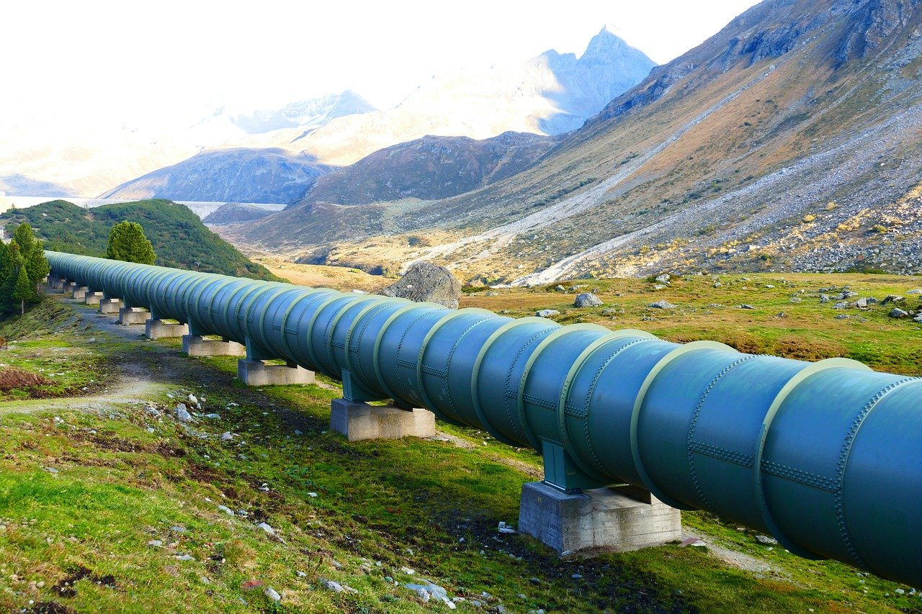

Conveyance of Water
[1]
Tutor
Asst. Prof. Shukra Raj Paudel
Department Of Civil Engineering
IOE, Tribhuvan University
Group members
Sandesh, 139
Sandip, 140
Sangita, 141
Sanjay, 142
Sanjeev, 143
Santosh, 144
2020-1-3
[1] : www.pixabay.com

Slide 2
Objectives of the Presentation
Types of Conduits considering topography, economy and construction practices
Pipe materials, their characteristics, advantages and disadvantages
Various pipe joints and their uses
Sequential steps involved in laying of pipes

Slide 3
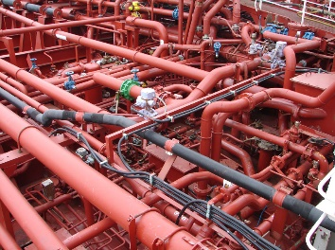
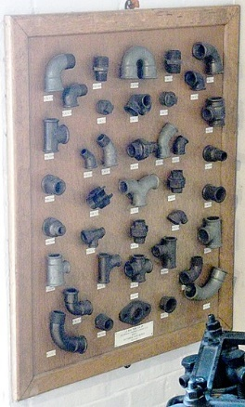
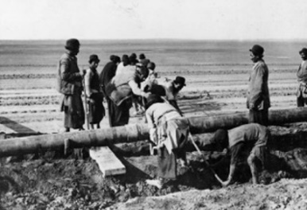
Presentation Outline
8.1 Pipe materials
8.1.1 Requirement of good pipe material
8.1.2 Types of pipe material
8.2 Pipe joints
8.3 Laying of pipes

Slide 4
How is water conveyed from source to consumer ?
By the means of either gravity or pressure conduits.
Gravity conduit | Pressure conduit
Water flows under the action of gravity and HGL coincide with water surface. At free surface, water will be at atmospheric pressure. Can’t go up or down as per topography of ground. For instances, open channels, tunnels, flumes and aqueducts. | Water flows under a pressure and generally HGL lies above conduits. No free surface exposed to atmosphere. Can go up or down as per topography of area. Siphonic action may take place. For instances, pipelines, pressure aqueducts and pressure tunnels.

Slide 5

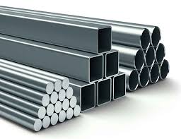
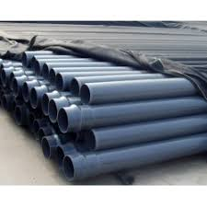
8.1 Pipe Materials
Should be resistant to possible chemical reaction, internal and external pressure.
Shouldn’t allow toxic substance to be released into water.
Source: https://commons.wikimedia.org/wiki/File:Piping_system_on_a_chemical_tanker.jpg

Slide 6
Requirement Of Good Pipe Material
Structural strength: Should be strong enough to bear both the internal and external pressure.
Durability: Should be more than design period.
Resistance to corrosion: Should be capable of offering resistance to corrosion.
Resistance to abrasion: Should be capable of offering resistance to erosion caused due to suspended solids.
Imperviousness: Shouldn't allow the entry of wastewater and groundwater into the pipe.

Slide 7
Requirement Of Good Pipe Material (contd)
Smoothness: Should be smooth and the Darcy coefficient of friction should be as low as possible.
Weight: Should be light in weight.
Easy to join: Should be easy to join different pipes.
Cost: Pipe materials should be such that the cost of pipe including handling , transportation and installation is less.

Slide 8
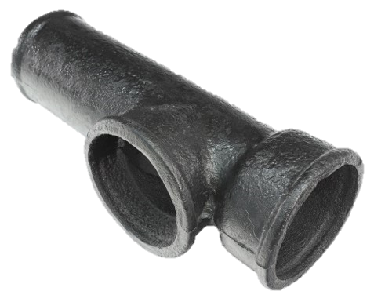
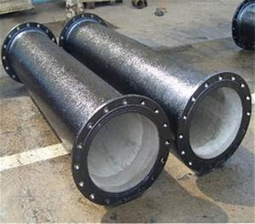
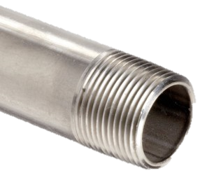
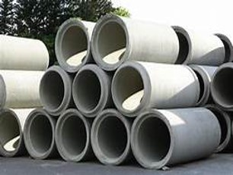
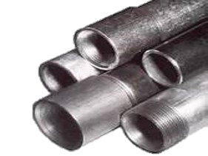
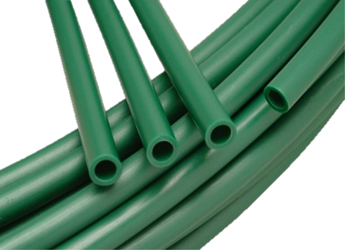
Types Of Material
Cast iron
Ductile iron
Steel
Cement Concrete
Galvanized iron
Plastic

Slide 9
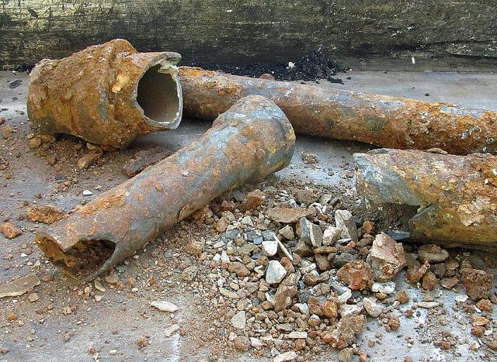
Cast Iron Pipes
Extensively used for conveyance of water in water supply system.
Life span of 100 years.
Manufactured by 2 methods:
Ordinary sand moulding process
Centrifugal process
Source:https://www.flickr.com/photos/newtown_grafitti/5099477424/

Slide 10
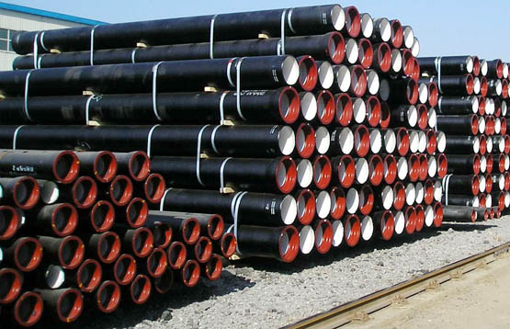
Cast Iron Pipes (contd)
Length: 3 to 6 meters
Classification:
Class LA (10 kg/cm²)
Class A (12.5 kg/cm²), 10% more thickness than LA
Class B (16 kg/cm²), 20% more thickness than LA
Source:https://www.flickr.com/photos/newtown_grafitti/5099477424/

Slide 11
Cast Iron Pipes (contd)
Advantages | Disadvantages
Highly resistance to corrosion and internal pressure. Strong, durable and easy to join. Easy Service connection. Moderate cost. | Heavy and difficult to handle and transport. Taste production due to iron leaching into water. Water carrying capacity decreases with time. Brittle.

Slide 12
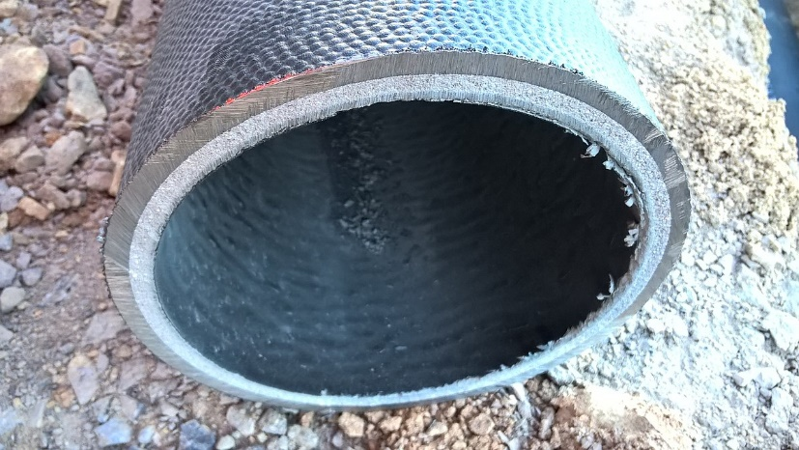
Ductile Iron Pipes
Manufactured from ductile iron using centrifugal casting.
Life span of 100 years.
Internal lining :
Cement mortar
Standard external coatings
Zinc or asphalt
Polyethylene wrapping
Source:https://en.wikipedia.org/wiki/Ductile_iron_pipe

Slide 13
Ductile iron pipes (contd)
Advantages | Disadvantages
Greater ductility and strength than cast iron pipes. Simple to join. Lighter than cast iron pipes. | Corrosion takes place. Internal and external protection system required. Polyethylene wrapping can be damaged.

Slide 14
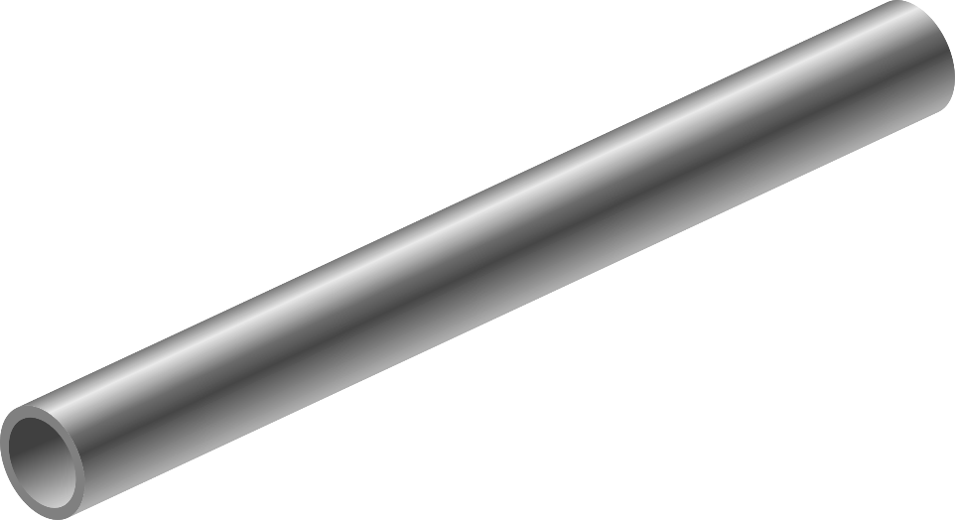
Steel Pipes
Fabricated by rolling the flat steels plates to proper diameter.
Joints may be transverse and longitudinal or transverse and spiral.
Length:12 m
Diameter:2400 mm
Source:https://en.wikipedia.org/wiki/Ductile_iron_pipe

Slide 15
Steel pipes (contd)
Advantages | Disadvantages
Cheap and strong to withstand the internal pressure. Flexible and easy to handle. Available in long length. | Cannot withstand the external loads. High maintenance cost and repairing time. Deformation in shape by combined actions of loads.

Slide 16
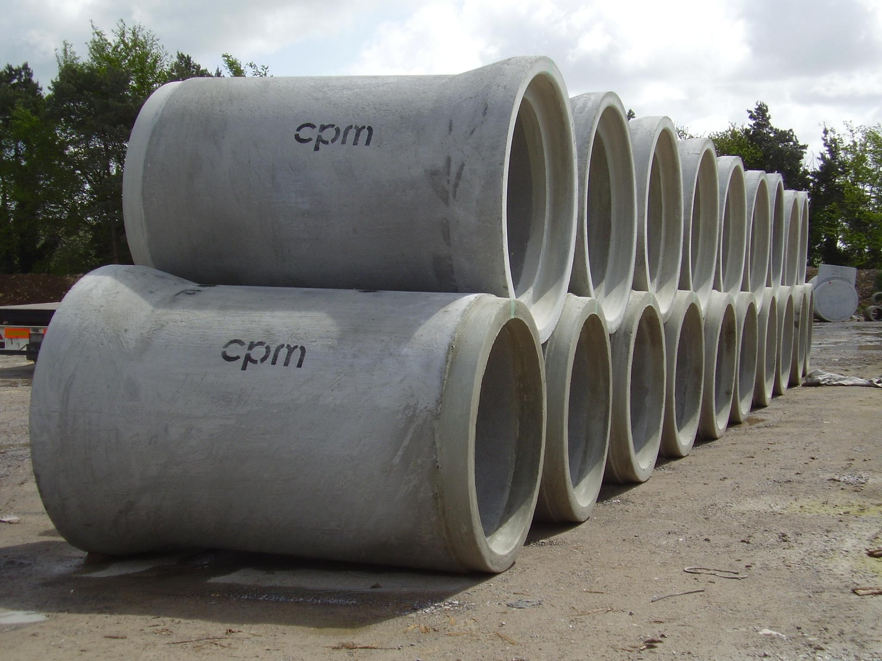
Cement Concrete Pipes
Either plain cement concrete or reinforced cement concrete is used.
Plain cement and reinforced cement concrete are used for heads up to 15 and 60 meters respectively.
Concrete pipes manufactured in the factories are precast (Hume) pipes and then transported to the site as a cast in situ pipes.
Source:https://en.wikipedia.org/wiki/cement_conc_pipe

Slide 17
Cement Concrete Pipes (contd)
Advantages | Disadvantages
Durable, life span of 75 years. Low maintenance cost and high resistant to corrosion. Inside surface can be made smooth Least coefficient of thermal expansion. | Unreinforced cement concrete pipes can’t withstand high pressure Difficult in repairing. Acids and alkalis can corrode. Leakages due to porosity and shrinkage cracks.

Slide 18
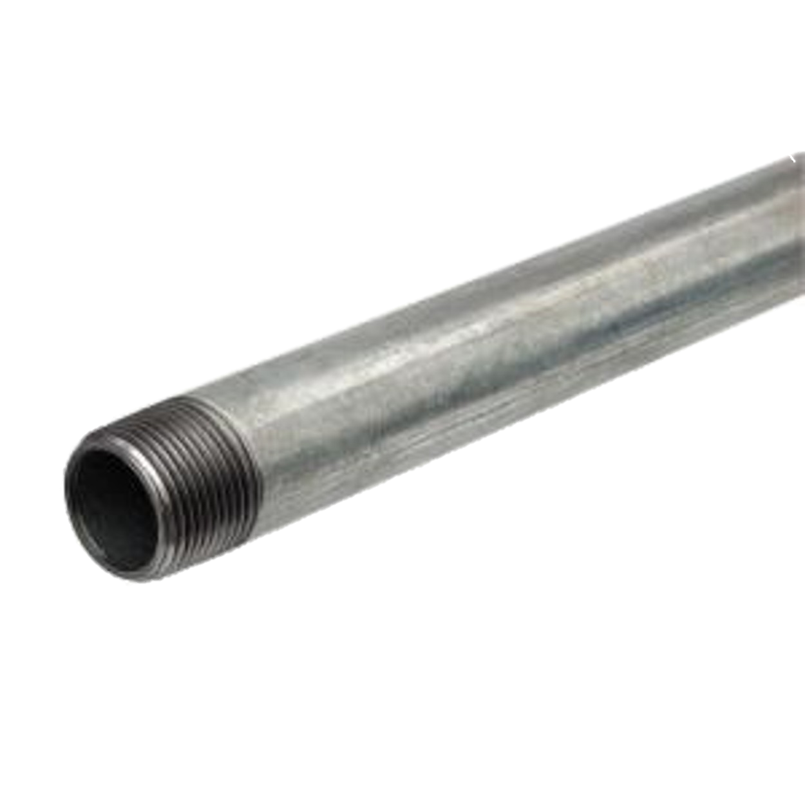
Galvanized Iron Pipes
Mild steel or wrought iron pipes provided with molten zinc.
Length of 6 meters.
Lifespan of 20 years.
Mostly joined by screwed socket joints.
Diameters : 15,20,25mm
Rating : More than 100m
Source:https://en.wikipedia.org/wiki/Ductile_iron_pipe

Slide 19
Galvanized Iron Pipes (contd)
Advantages | Disadvantages
Cheap and light in weight. Can be easily cut and threaded. Easy to join. Can withstand internal pressure up to head of 180 m. | High cost when diameter>80mm Less durable. Corrosion may take place. Smoothness decreases with time

Slide 20
Plastic Pipes
Made from synthetic resin of high molecular weight.
Polymerized from simple compounds by heat , pressure and catalyst.
Raw materials comes from petroleum and natural gases.
Polyvinyl Chloride Pipes(PVC)
Polyethylene pipes(PE)
Polypropylene Random Copolymer pipes(PPR)
Types

Slide 21
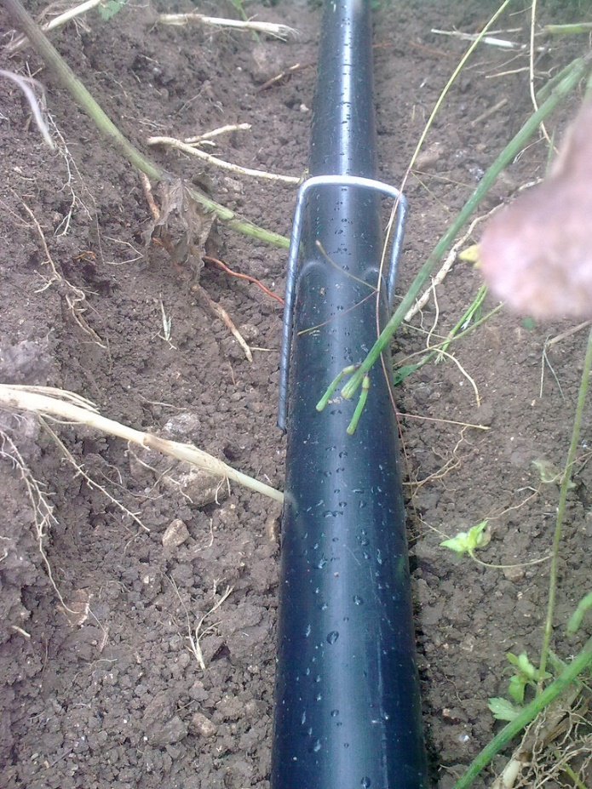
Polyethylene (PE) Pipes
Depending on product quality, they are of three types:
1. High density polyethylene(HDPE)
2. Medium density polyethylene(MDPE)
3. Low density polyethylene(LDPE)
HDPE is used for enduring high pressure.
Source:https://en.wikipedia.org/wiki/poly_ethene_pipe

Slide 22
Polyethylene (PE) Pipes (contd)
HDPE is made from ethylene.
HDPE pipes are available in series of 2,2.5,4,6 and 10 kg/cm2 which can withstand the internal pressure of 20,25,40,60 and 100 meters respectively.
Life span of 100 years.
Uses :
Used for gravity flow in rural areas.
Used in various underground condition.

Slide 23
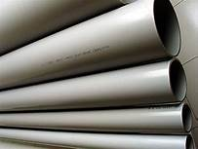
Polyvinyl Chloride (PVC)Pipes
Made from a plastic and vinyl combination material.
PVC is an inert and stable material that resists corrosion.
Used in:
Residential plumbing.
Water system, underground wiring and sewer lines.
Good in cold climate.
Source:https://en.wikipedia.org/wiki/p_v_c

Slide 24
Polypropylene Random(PPR)Pipes
Thermoplastic resins produced through the polymerization of propylene with ethylene links introduced in the polymer chain.
General types of polypropylene:
1.Homo polymer
2.Random polymer
3.Block polymer

Slide 25
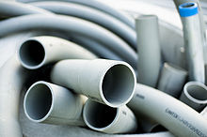
Polypropylene Random(ppr) Pipes (contd)
Ethylene propylene rubber or EPDM added to polypropylene homo polymer increases its low temperature strength.
Decreased crystallinity due to randomly polymerized ethylene monomer added to polypropylene homopolymer.
Used in:
Cold and hot installations.
Swimming pools and compressed air plants.
Transportation of corrosive fluids like acids and industrial products.
Source: https://commons.wikimedia.org/wiki/File:Piping_system_on_a_chemical_tanker.jpg

Slide 26
Pipe | Advantages | Disadvantages
Polyethylene pipes(PE) | Cheap and smooth and easy to join. High durability and easy to maintain. Corrosion free and resistant to chemicals. | Poor temperature capability and are not good for carrying hot water. Less resistant to weathering. High thermal expansion. Produce taste in water when temperature is high.
Polyvinyl chloride pipes(PVC) | Cheap and easy to join Made of plastic and vinyl combination material. Inert and stable material. | Brittle and poor temperature capability. Less resistant to weathering. Outdoor installation cannot be done.
Polypropylene Random(PPR) pipes | Low chances of failure. High temperature resistant Eco friendly and fully recyclable. No problems of calcification. Non deforming and smooth. | Outdoor installation cannot be done. Repairing can only be done by making use of a fusion welding tool.

Slide 27
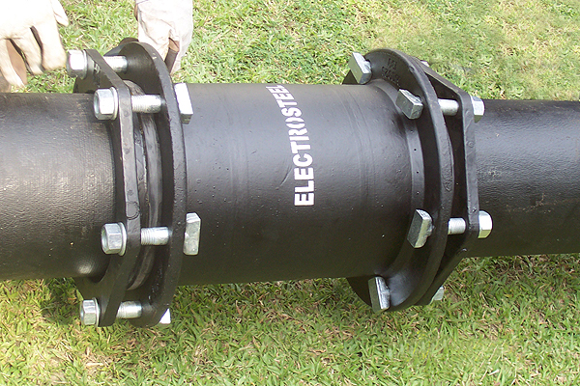
8.2 Pipe Joints
Why joints?
Length of pipeline ⇒ kilometers
Length of pipes ⇒ 2 to 6 meters To join together pipes of smaller lengths.
Selection Criteria
Pipe materials
Internal pressure
Durability
Water tightness
Site conditions, etc.
[2]
[1]
[1] : Water Supply Engineering, Prof.Dr.Bhagwan Ratna Kansakar, First Edition, Pg. 337
[2] : https://www.electrosteelcastings.com

Slide 28
Pipe Joints (contd…)
Pipe Joints
Socket and Spigot joint
Tyton joint
Flanged joint
Collar joint
Screwed socket joint
Expansion joint

Slide 29
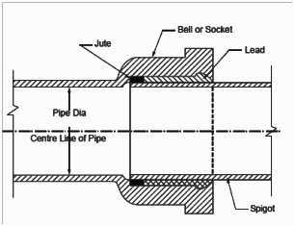
Socket and Spigot Joint
[1]
Enlarged Socket End (Bell End)
Normal Spigot End
Strands of jute or hemp
1
Rubber gasket over hemp
2
Insertion, alignment, centering
3
[1] : https://civilatwork.blogspot.com
4
5

Slide 30
Socket and Spigot Joint (contd…)
[1]
Molten Lead in annular space
Lead solidifies on cooling
Caulking ⇒ water tight joint
6
7
8
[1] : https://civilatwork.blogspot.com

Slide 31
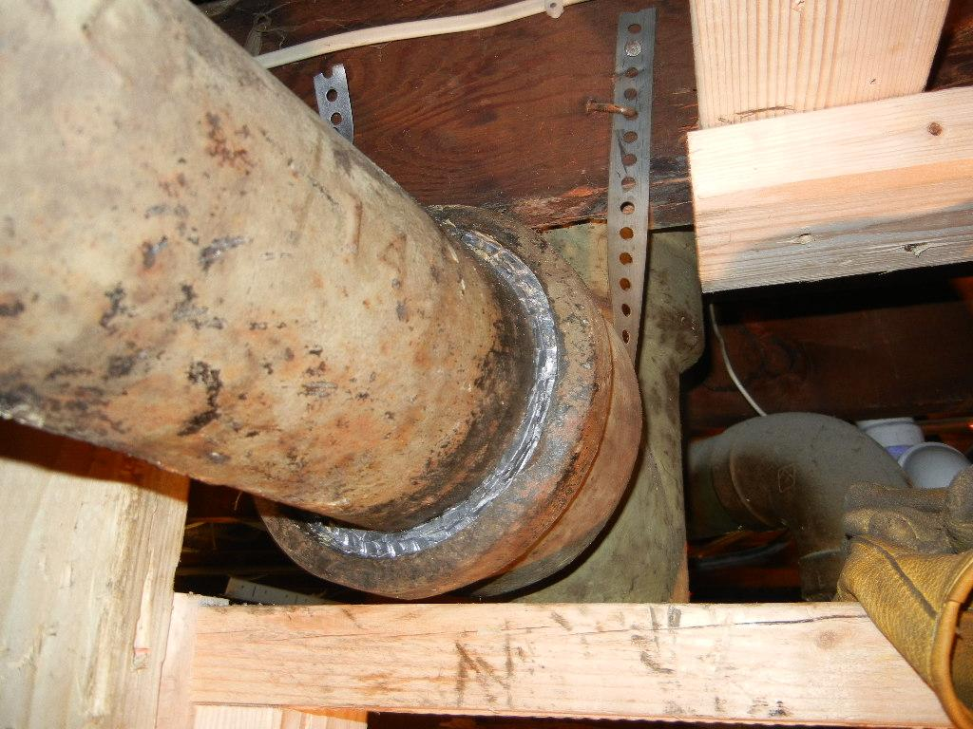
Socket and Spigot Joint (contd…)
[1]
Caulking
The process of making joint water tight
Done by solidifying molten lead in annular space.
Lead use per joint : 5kg for 150mm dia pipe 50kg for 1200mm dia pipe [2]
Also called ‘run lead joint’
[1] : https://www.ridgidforum.com
[2] : Water Supply Engineering, Prof.Dr.Bhagwan Ratna Kansakar, First Edition, Pg. 338

Slide 32
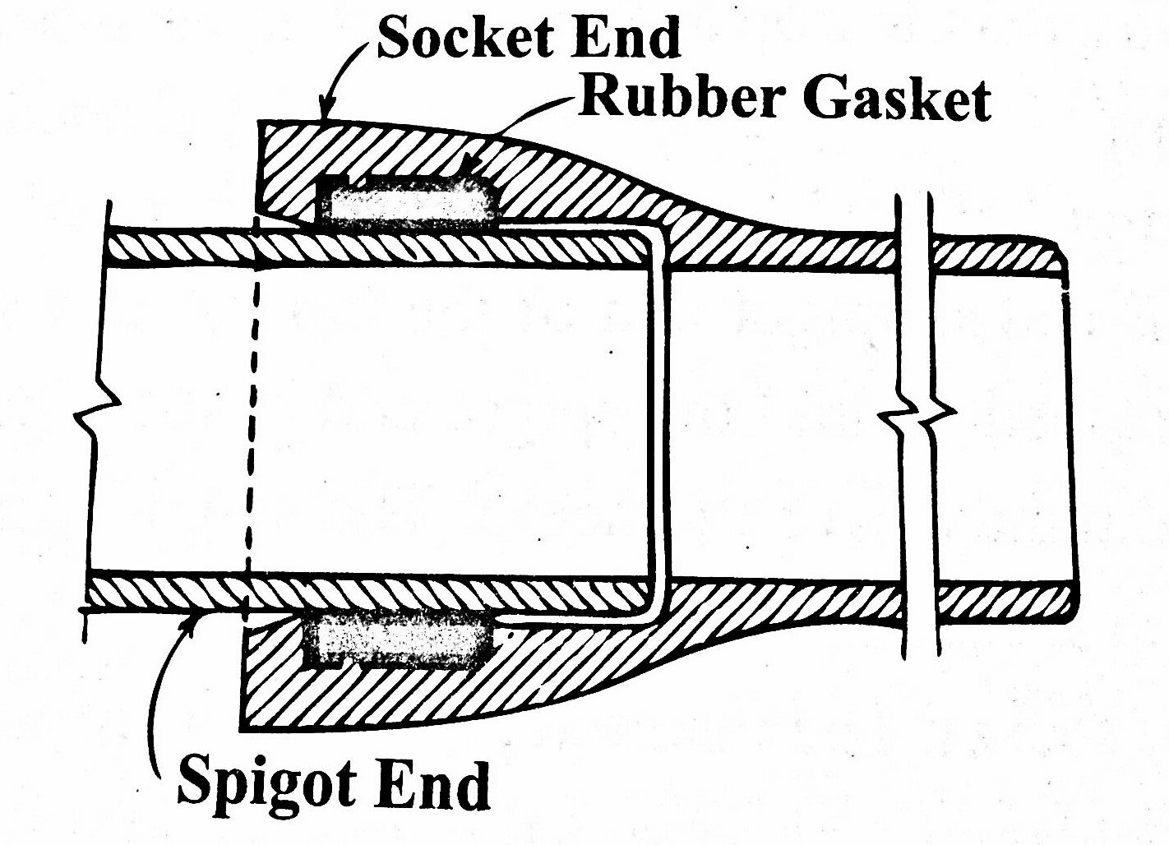
Tyton joint
[1]
Enlarged Socket End
Normal Spigot End
Rubber gasket on Socket end
1
Chamfered lubricated socket
2
3
[1] : https://www.kullabs.com
4

Slide 33
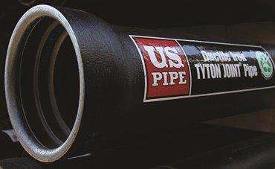
Tyton joint (contd…)
[1]
Also called push on joint or push on flexible joint.
More flexible than lead joint
Most commonly used for cast iron and ductile iron pipes.
Joint is made watertight by compression of gasket. (approximately by 50%)[2]
[1] : http://www.binhindi.com
[2] : Water Supply Engineering, Prof.Dr.Bhagwan Ratna Kansakar, First Edition, Pg. 338

Slide 34
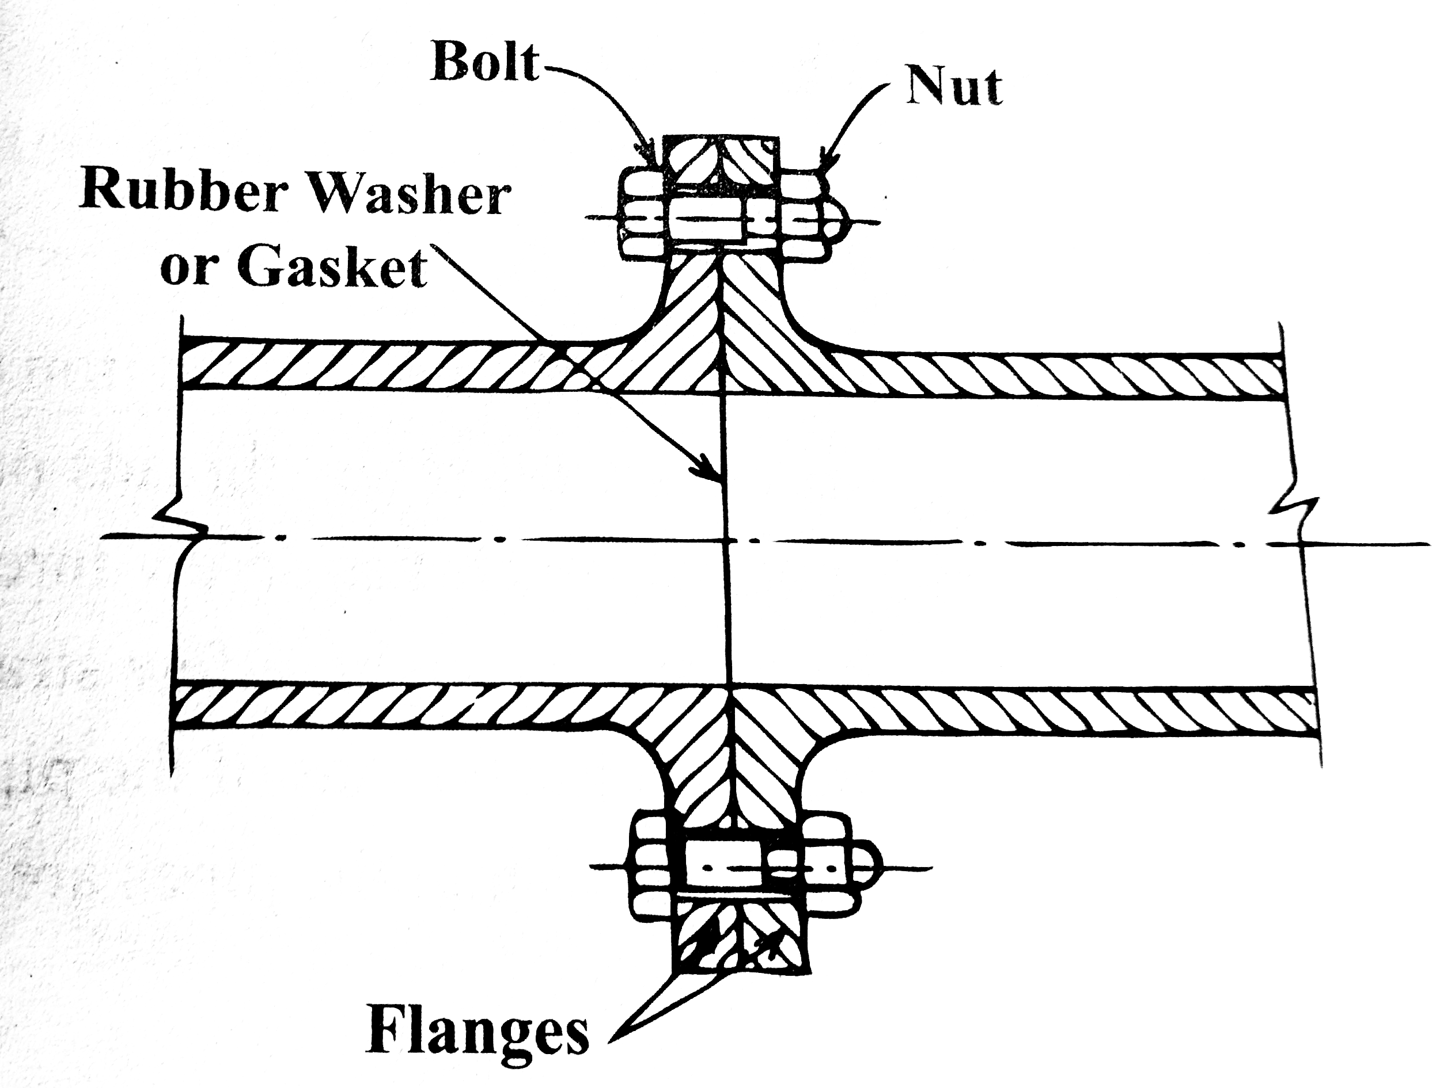
Flanged joint
[1]
Both ends flanged
To make water tight :
Rubber gasket / washer
1
Canvas or Lead
2
[1] : Water Supply Engineering, Prof.Dr.Bhagwan Ratna Kansakar, First Edition, Pg. 339

Slide 35
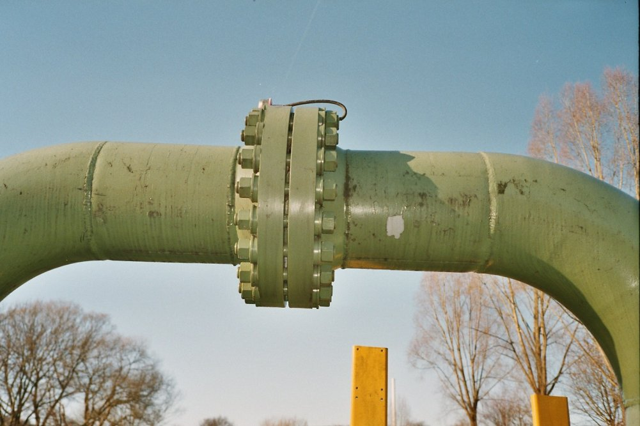
Flanged joint (contd…)
[1]
Flanges:
External ridge for attachment
Casted on pipes during manufacture
Screwed or bolted
Used for temporary pipelines:
Pumping stations
Treatment plants
Hydraulic labs
Boiler house
Easy to dismantle and reassemble
[1] : https://it.wikipedia.org/wiki/Flangia

Slide 36
Flanged joint (contd…)
[1]
Rigid joint Can’t be used if deflections and vibrations are expected.
Commonly used for:
Cast Iron pipes
Ductile Iron pipes
Steel pipes
Galvanized iron pipes
[1] : https://it.wikipedia.org/wiki/Flangia

Slide 37
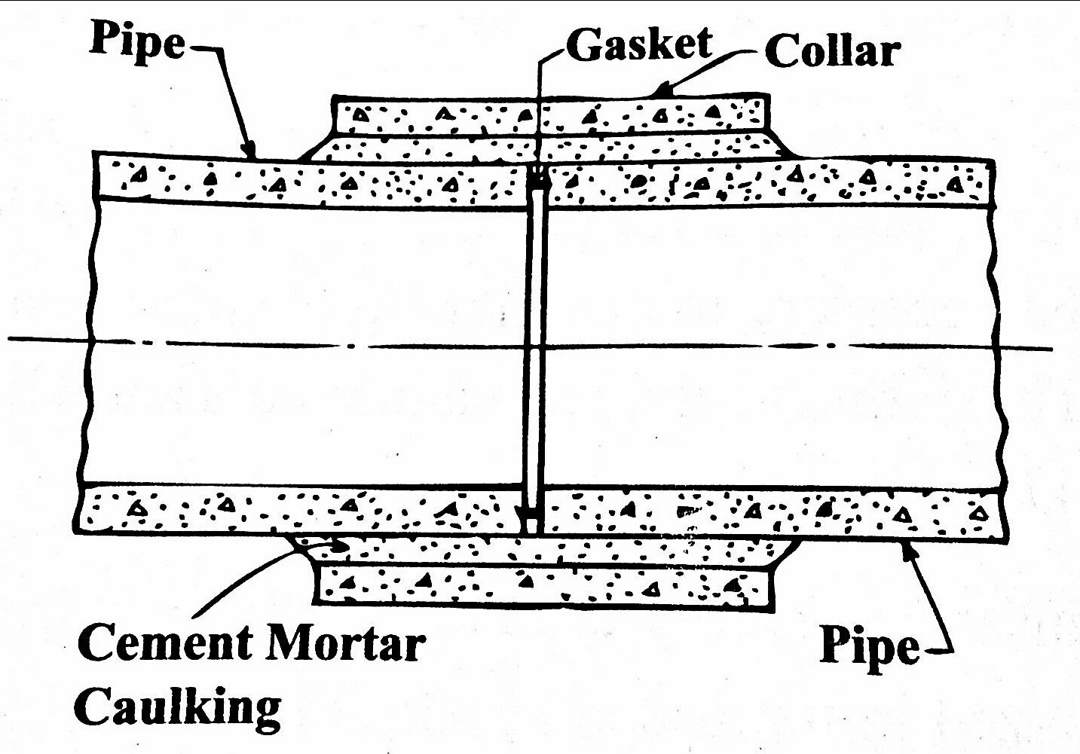
Collar Joint
[1]
Reinforced concrete collar
Grooved ends
Rubber gasket between steel rings
1
1:1 cement mortar finish
[annular space]
2
Side angle = 45 degrees
3
[1] : Water Supply Engineering, Prof.Dr.Bhagwan Ratna Kansakar, First Edition, Pg. 340
4
5

Slide 38
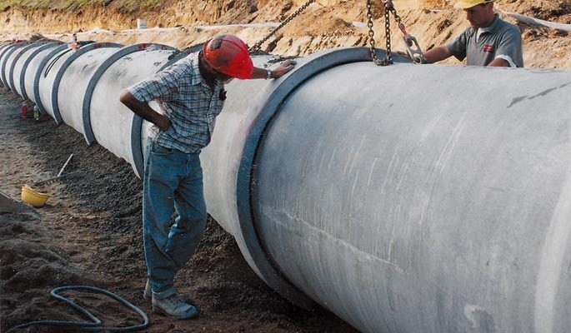
Collar joint (contd…)
[1]
Jute or hemp soaked in concrete may be used instead of rubber gasket
Pipes are first aligned and centered, and collar is slipped over.
Used for Cement Concrete pipes with Plain ends
[1] : https://www.hynds.co.nz

Slide 39
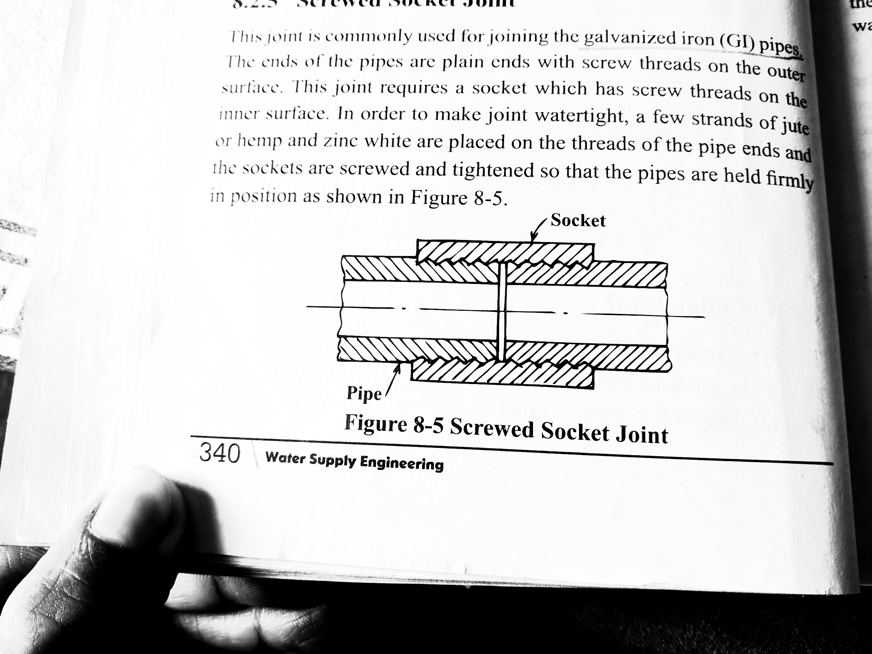
Screwed Socket Joint
[1]
For GI pipes (Galvanized Iron)
External screw threads on ends
Socket with internal threads
1
Strands of jute/hemp and zinc white on threads [water tight]
2
3
[1] : Water Supply Engineering, Prof.Dr.Bhagwan Ratna Kansakar, First Edition, Pg. 340
4

Slide 40
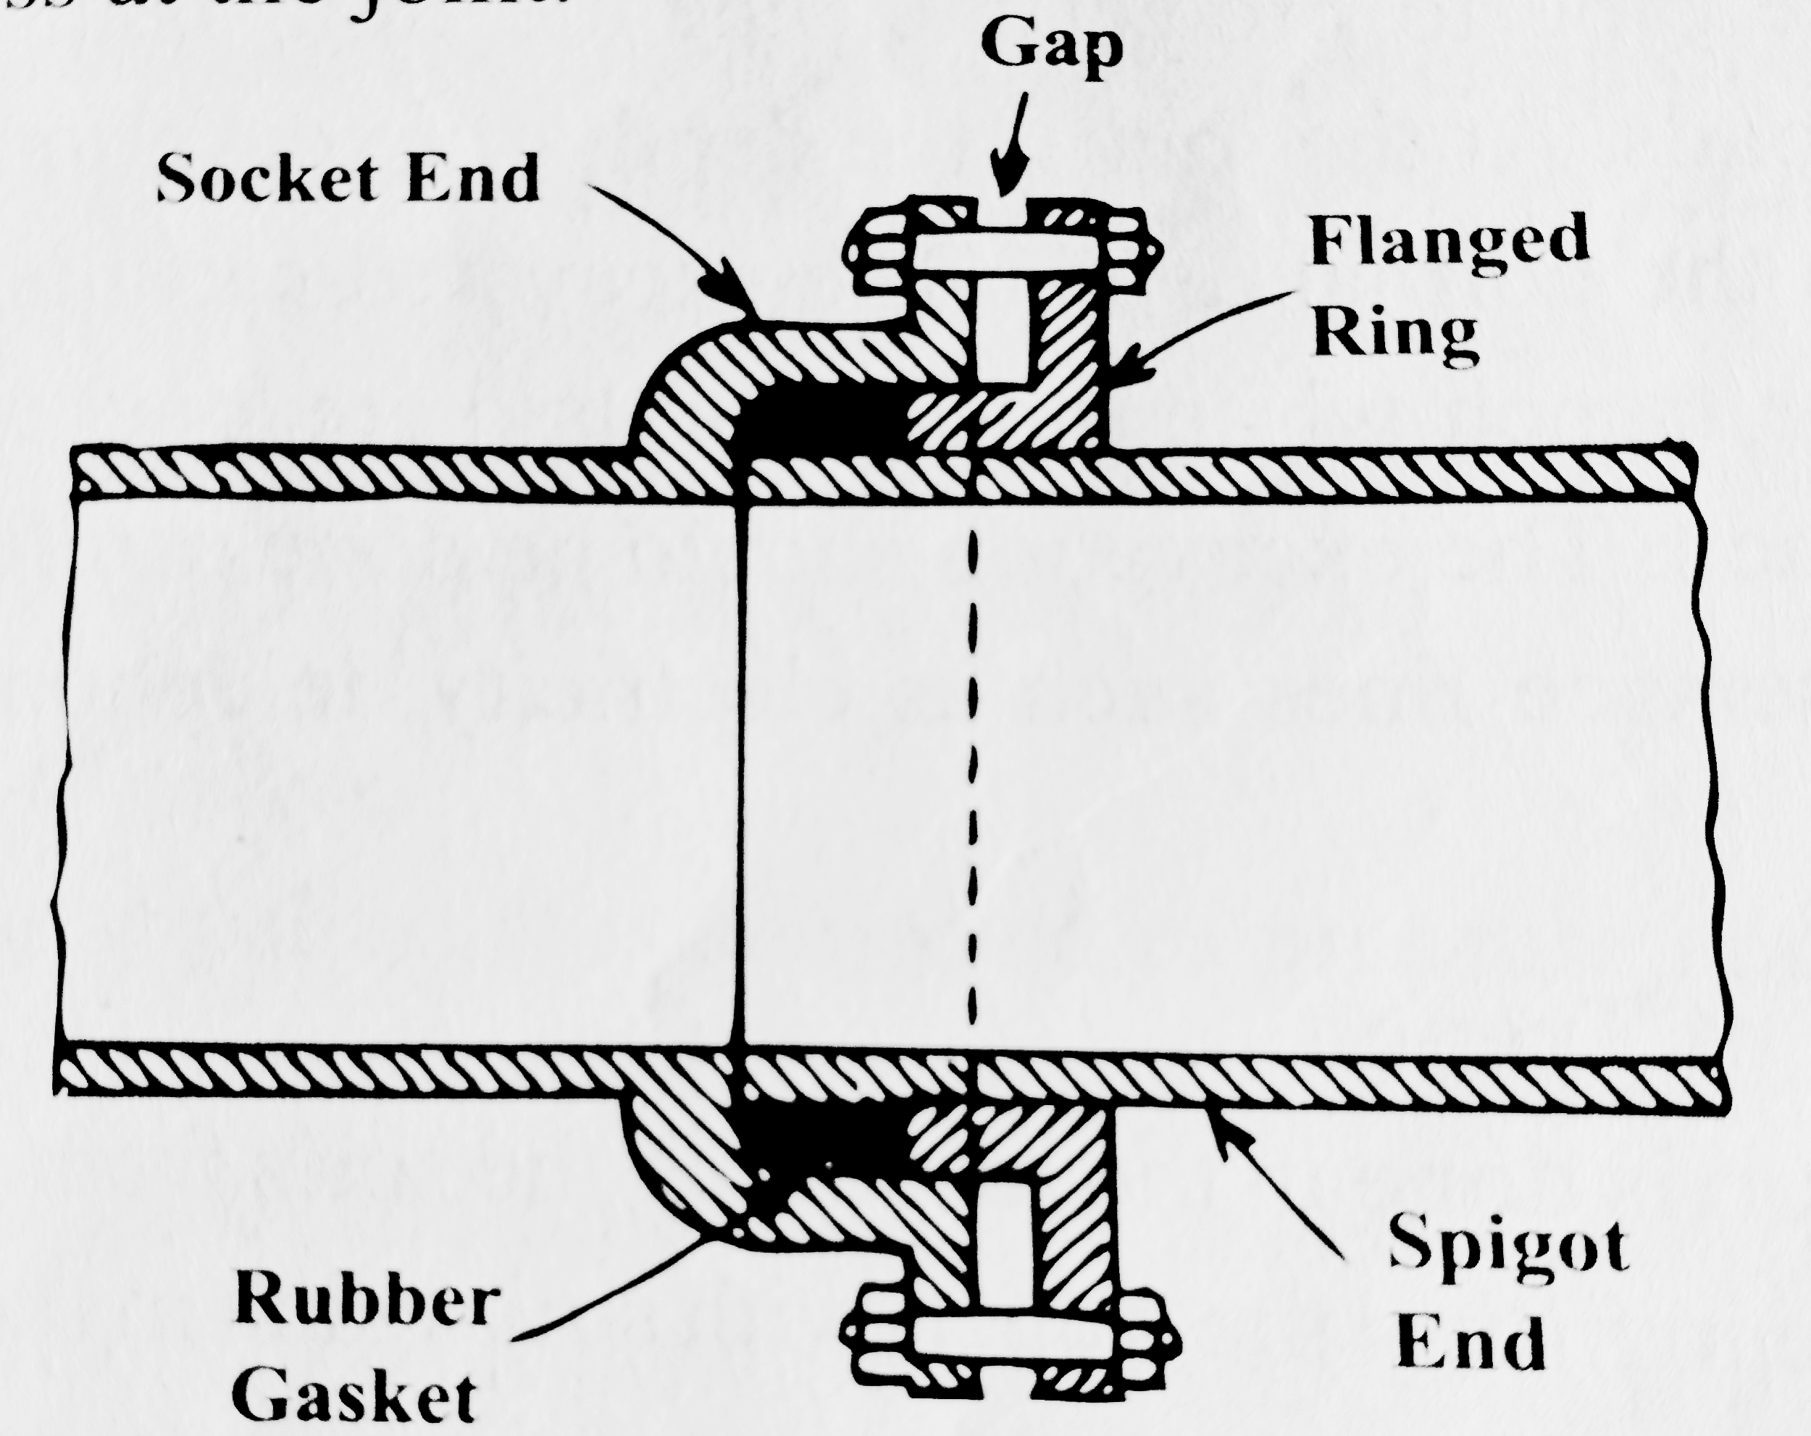
Expansion joint
[1]
Flanged Socket end
Normal Spigot end
Cast Iron Follower Ring
1
Rubber gasket
[to absorb variation in length]
2
3
[1] : Water Supply Engineering, Prof.Dr.Bhagwan Ratna Kansakar, First Edition, Pg. 340
4

Slide 41
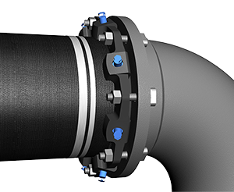
Expansion Joint (contd…)
[1]
Used when temperature strain is considerable
Rubber gasket is placed on spigot end
Follower ring is placed on spigot end far from pipe end
Socket and spigot ends are aligned and centered
Follower ring is bolted to flange of the socket
[1] : https://www.ebaa.com

Slide 42
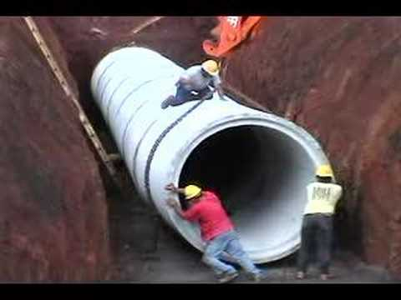
8.3 Laying of Pipes
Done after completion of survey, design work, preparation of drawing and specifications and procurement of materials.
Setting out
Excavation of trench
Timbering of trench
Preparation of Subgrade
Laying and Jointing of pipes
Testing of pipeline
Backfilling of trench
Source:https://en.wikipedia.org/wiki/pipe_laying
Disinfection of Pipeline

Slide 43
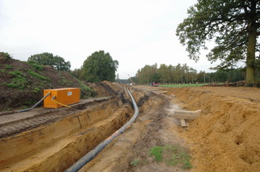
Setting Out
Different points along the centerline of pipe line is transferred.
Pipeline alignment is marked on the ground by driving stakes.
30m apart in straight line.
7.5 to 15m for curve alignment
http://www.fluxys.com/belgium/en/Fluxys%20nearby/PipelineLaying/Progress/Preparation.aspx

Slide 44
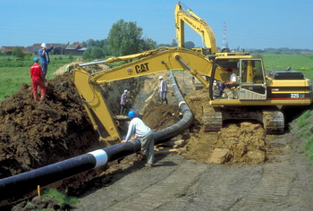
Excavation of Trench
Trench is excavated along the alignment of pipeline.
Width = 30 cm + diameter of pipe
Depth = 90ch + diameter of pipe
Source: http://www.fluxys.com/belgium/en/fluxys%20nearby

Slide 45
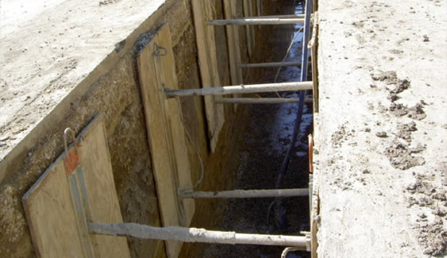
Timbering of Trench
It is done in loose soil to prevent soil from caving in.
Done by wooden planks which are supported by timber blocks, wedges and struts.
Sometime iron sheets are used instead of wooden planks.
Not required in hard and clay soil.
Source: http://pacificshoring.com/store/vertical-aluminum-hydraulic-shoring.html

Slide 46
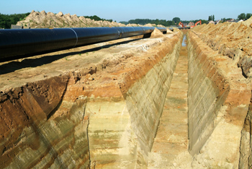
Preparation of Subgrade
Bed of trench is prepared exactly same as the gradient of pipeline.
For soil where settlement is likely to take place, simply ramming a 15 to 30 cm thick layer of sand or clay is done.
But 15cm thick cement concrete bed is made in case of soil liable to settlement.
Source: http://www.fluxys.com/belgium/en/Fluxys

Slide 47
Laying and Joining of Pipes
It is done manually or using mechanical devices depending on size of pipes.
Utmost care is taken to prevent the outer protective coating of pipe from being damaged
Joints are made using suitable joint.
Source: http://www.fluxys.com/belgium/en/Fluxys

Slide 48
Testing of Pipeline
It is done as laying of pipeline proceeds for every 500m or less.
Pressure Test:
Pipe is tested with a pressure of 0.5N/mm² or 1.5 times the working pressure whichever is greater.
Manually or power driven test pump is used depending on size of pipe. If fall of head or pressure is dropped then the test is not passed.
Notes:
/

Slide 49
Testing of Pipeline (contd)
II. Leakage Test
Pipe full of water at pressure from pressure test is left for certain time
Due to leakage, there will be drop in pressure
Water is added to maintain the balance pressure. Amount should be within allowable limit.
Notes:
/

Slide 50

Testing of Pipeline (contd)
Where,
Q = allowable leakage in cm³/hr
N = no. of pipe joints in test section
D = Diameter of pipe in mm
P = Applied test pressure in kg/cm²
Notes:
/

Slide 51
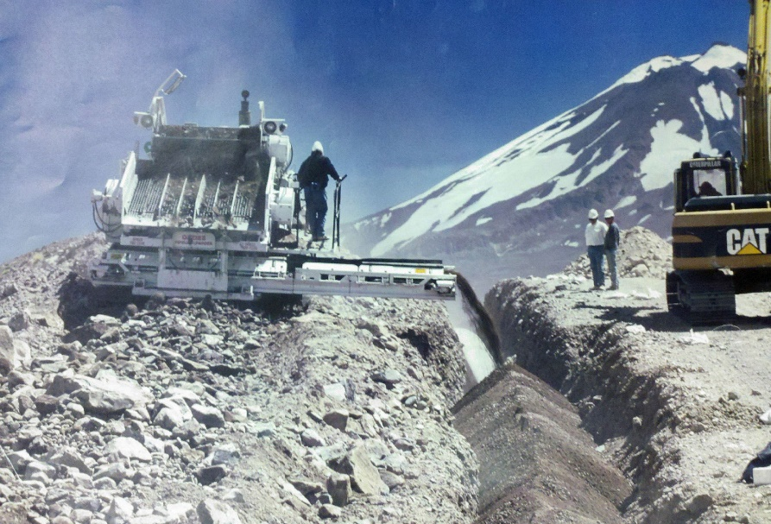
Backfilling of Trench
Excavated soft material is used.
Done in layers of 15 to 30 cm, each layer is well rammed.
Should be done up to the ground level or sometime 15 cm above the ground level which will be consolidated later.
All surplus should be disposed.
Source:https://en.wikipedia.org/wiki/GasAndes_Pipeline

Slide 52
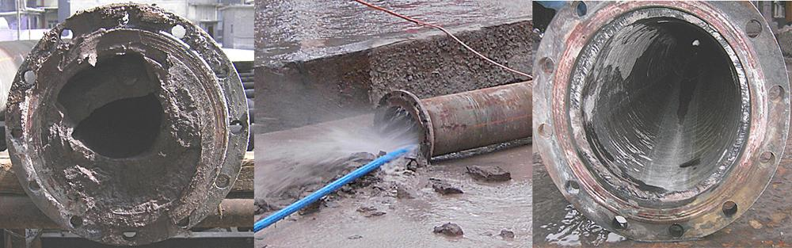
Disinfection of pipeline
Pipeline is filled with chlorinated water with 50 mg/l of residue chlorine for 12 hours.
Followed by flushing with fresh water.
Not necessary for pipeline from source to treatment plant.
Source:https://en.wikipedia.org/wiki/GasAndes_Pipeline

Slide 53
Thank You
Queries?

